Slide 1
Steering Team - Lower Minnesota River West Comprehensive Watershed Management Partnership
8/6/2020

Slide 2
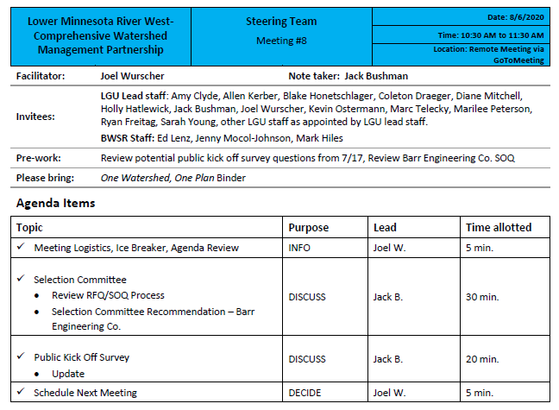

Slide 3
RFQ/SOQ Process – Timeline
Issue Date: July 2nd
SOQ Deadline: July 20th
Independent Review of SOQs: July 21st – 26th
Selection Committee Meeting: July 27th
Interviews: 29th and 30th

Slide 4
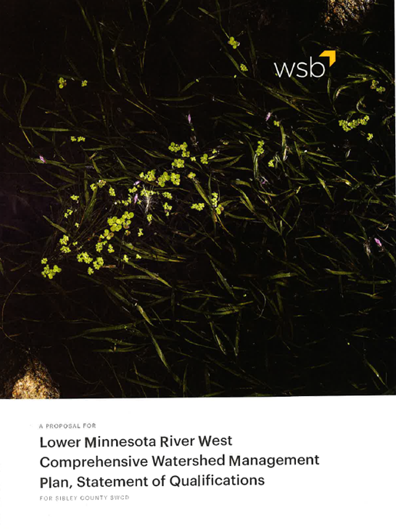
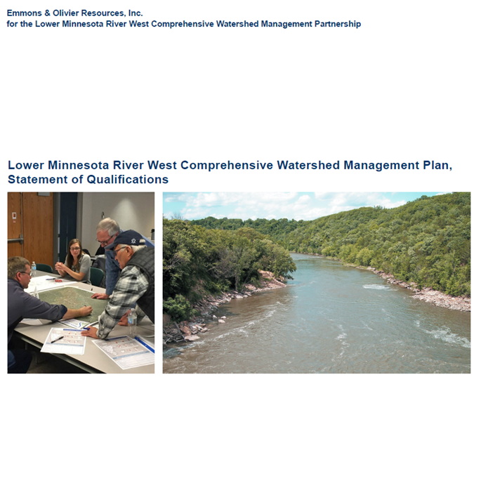
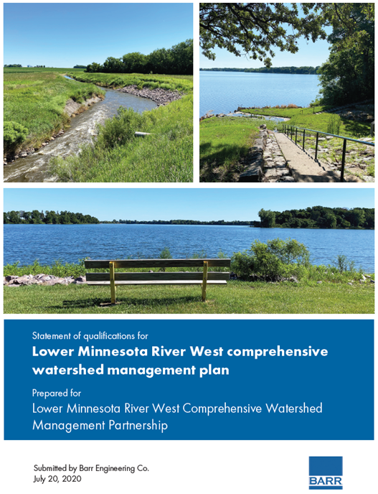
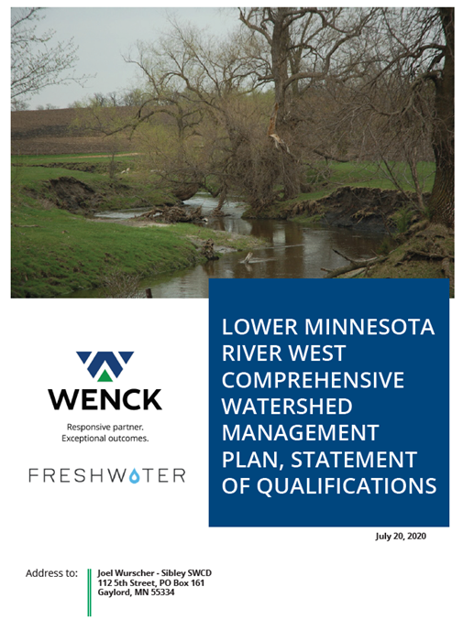
SOQ Review
HEI
WSB
EOR
Barr w/ SEH
Wenck w/ Freshwater Society

Slide 5
Interviews

Slide 6
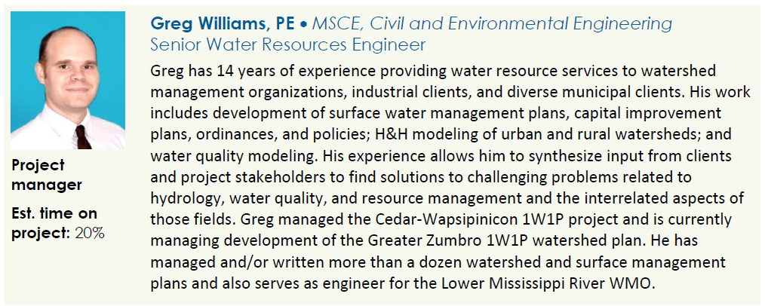
Barr Engineering Co. w/ SEH

Slide 7
What's Next?
Policy Committee Approval (8/6/2020)
Sibley County Board Approval (8/11/2020)
Contract Negotiations & Contract Approval

Slide 8
Public Kick Off Survey
Lots of good feedback on initial draft
Will edit based on feedback, send out update by 8/20

Slide 9
Next Meeting
September 3rd @ 10:30 AM via GoToMeeting

